Slide 1



Trains vs Planes: The True Cost of Travel
Makeover Monday 2018
Suyin Lee & Andreas Lezis

Slide 2
Context: Deutche Welles

Slide 3
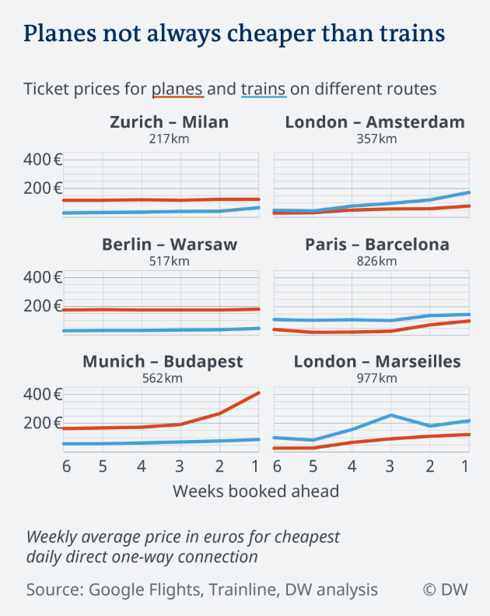
Original Visualization
Examines monetary cost of travel (vertical axis) as a function of number of weeks booked ahead (horizontal axis)
Faceted by six Origin-Destination
Colored by mode of travel (red = plane and train = blue)
Note the fifth variable: distance (km) between each Origin & Destination
Note the legend

Slide 4
Weaknesses of this visualization?
No information stated on graph on when the data was collected
Not clear how the facets are sorted (if they’re sorted at all)
Not clear where the data for the distance (km) represents, unknown source
Should we care more about absolute differences in cost (as this graph shows), or relative differences?

Slide 5
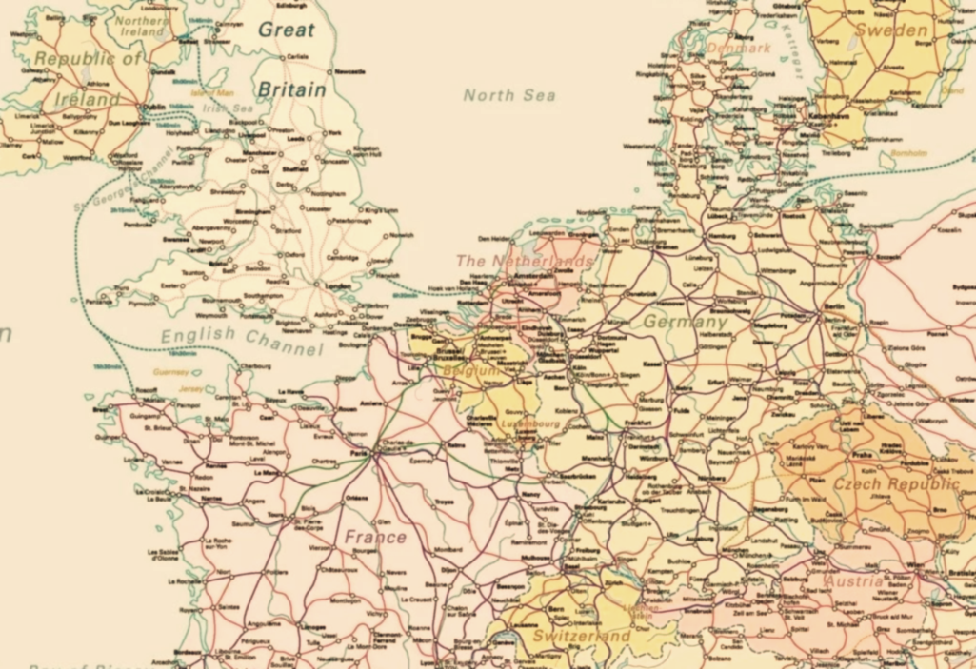
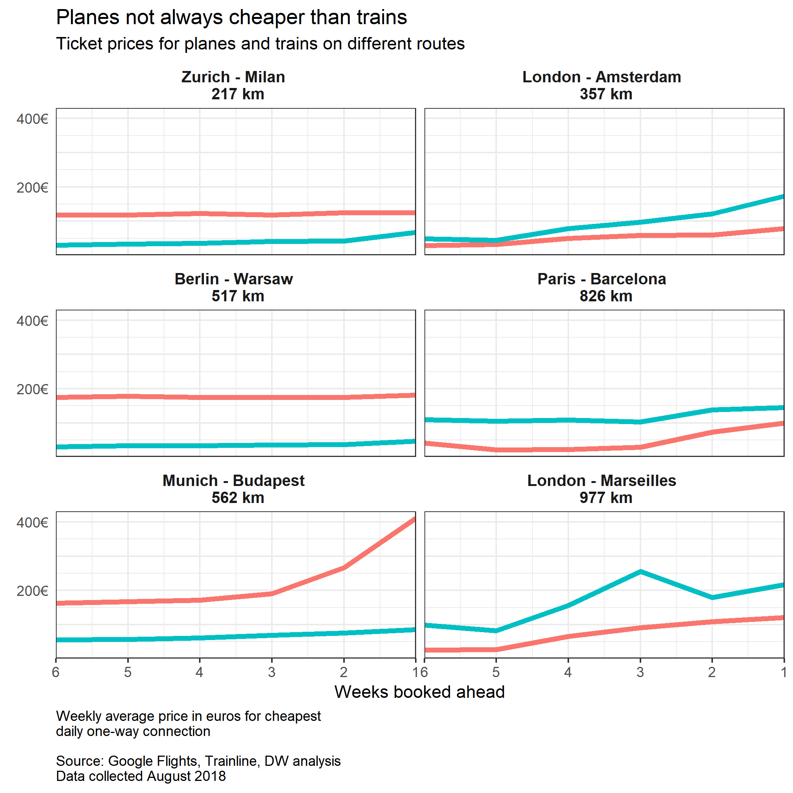
Recreate Original Visualization
/Suyin will populatte

Slide 6
Improving the Original Visualization

Slide 7
Indifferent between Mode of Travel

Slide 8
Original Visualization: Time
Examines time “cost” of travel (horizontal axis) for each of six routes (vertical axis)
It’s animated! The animation introduces a new variable: time delay, i.e. the “actual” time cost (applies to planes only)
Colored by mode of travel (red = plane and train = blue)
Note that the time axis is labelled in 30 minute increments
Note the legend

Slide 9
Weaknesses of the visual?
When were these data collected?
Questionable assumptions underlying the “actual” time
Does the dotted vertical line really convey any additional information?
The frame changes are frustrating and do not enhance our ability to understand the data!

Slide 10
Recreate Original Visualization
Required three geoms to plot:
“Displayed time” geom_point
“Actual time” geom_point
geom_segment
gganimate (not yet available on CRAN). Requires a dedicated variable to map to each “frame” of the animation (only 2 here)
A lot of data wrangling was required to prepare the dataset

Slide 11
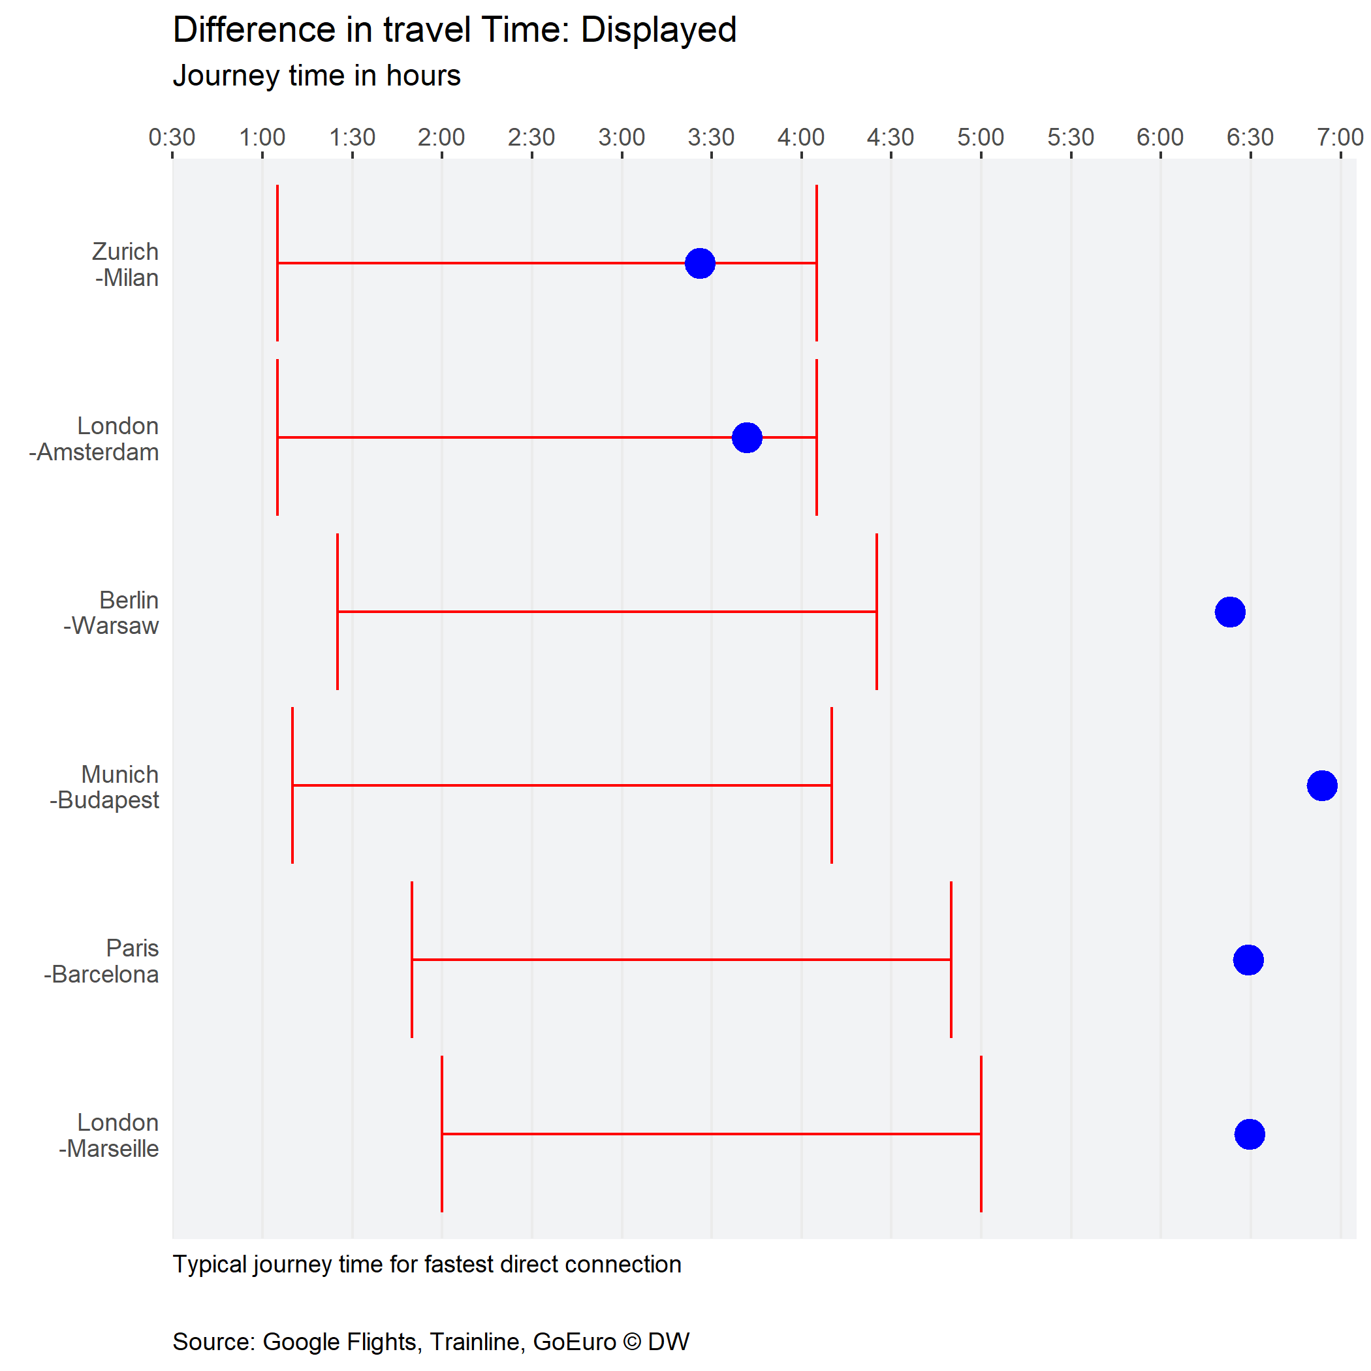
Improving the Original Visualization
Let’s face it… the animation makes it harder to understand the data, not easier
The assumed delayed applied to all plane trips may not be reasonable, or universally applicable – there are ways of conveying the spread of data

Slide 12
Challenges
Recreating the visual – cost
Underlining planes vs. trains as the legend

Slide 13

Further Developments
Understanding how travel seasons impact the cost of tickets
This Photo by Unknown Author is licensed under CC BY-NC-ND

